Slide 1

25-01-2024 | Git training advanced | Wilbert van Dolleweerd
Notes:
Mezelf voorstellen. Wie ben ik en wat doe ik?
Voorstelrondje met te beantwoorden vragen:
Wie ben je en wat is je rol binnen ICT?
Hoe ben je betrokken binnen je projecten met Git?
Wat verwacht je te leren (opschrijven op whiteboard)?

Slide 2

Version 0.1.0
Notes:
Training bijgewerkt nav eerdere ervaringen. Als er vragen/opmerkingen zijn, mail me.

Slide 3
Git and new projects – how to configure?
My rule:
“Anything that can be considered to have a specific life-cycle, should have its own repository.”

Slide 4

Git and new projects – examples
You are starting a new project which will result in a single executable.

Slide 5
Git and new projects – examples
You are creating a desktop client where you interface with a database. The databases SQL scripts are maintained by a third-party. You expect multiple releases of the scripts.
Desktop client
Third party database

Slide 6
Git and new projects – examples
You are creating a web frontend that communicates with a REST API also designed by you. The REST API can progress individually from the web frontend.
Web frontend
REST API

Slide 7
Git and new projects – examples
You are starting a new project with a microservice architecture where you will deploy multiple microservices.
Microservice
Microservice
Microservice
Microservice

Slide 8
Combining multiple Git repositories
You are working on a project while simultaneously also developing a shared library that you want to re-use and release later. How would you do this?
Using your architecture. Publish your library as an artifact and consume it from your application. Your application is contained in a separate Git repository as well as your library.
Cons: cumbersome while the library is still in development (and your application is driving that development).
Using Git Submodules to add a source dependency in your application.
Cons: No longer recommended, so will not be discussed in detail.
Using Git Subtree. Similar in functionality to submodules but more recent and with less steps.

Slide 9
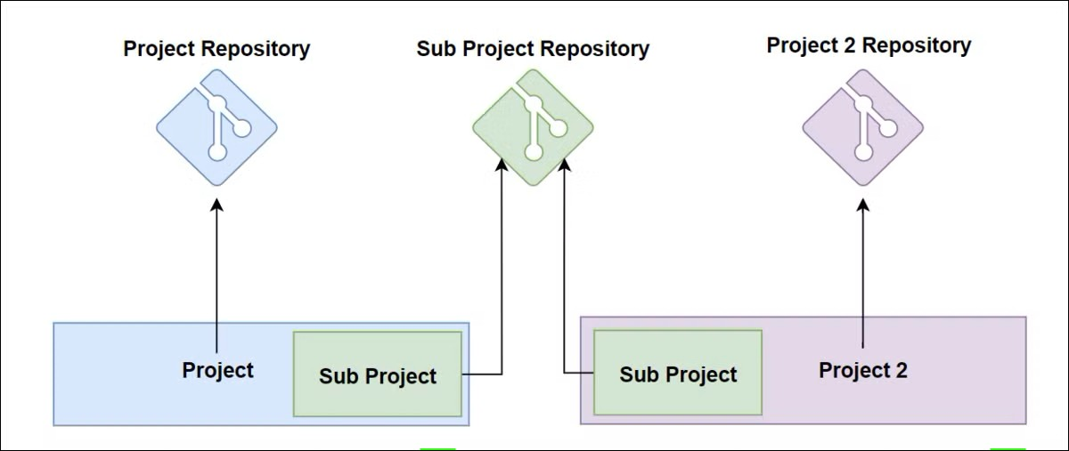
Git subtree explained

Slide 10
Git subtree usage
Getting the library in your repository:
Add the shared library as a remote
Use subtree to download the sources in the existing repository
When necessary, update the subtree with changes from the remote
Pushing changes back into the library:
Make a change in the dependency folder and add it to the repository
Push changes back into the remote (make sure that you have sufficient rights)
Notes:
Create a new empty Git repository with one commit.
Clone the aspnet.core repository to a new local, bare repository.
git clone https://github.com/dotnet/aspnetcore.git --bare
Add aspnetcore repository as a new remote.
git remote add aspnetcore ..\aspnetcore.git\
Git subtree initialiseren
git subtree add --prefix library aspnetcore main --squash
Updating an existing Git subtree
git subtree pull --prefix library aspnetcore main --squash
Show with gitk what happens
Creating a changed in the subtree repository and pushing this back.
Create a change in the library folder. From the root of the repository use the following command.
git subtree push --prefix=dependency aspnetcore main

Slide 11
Use the SHA to your advantage
The SHA (hash) uniquely identifies a commit. You can use this to your advantage in your project.
Add a HTTP header to your REST API with the SHA
Inject the SHA into your application to be shown in a help/about dialog
Print the SHA in the beginning of your technical log file when starting your application
This gives you the possibility to remotely query what version is installed at a customers location.
You can use a tool like GitVersion to extract this information from your Git repository in your build process. GitVersion started as a .NET tool but is available for multiple platforms.
Notes:
Show release from MO99 with the version number injected in the assembly.

Slide 12
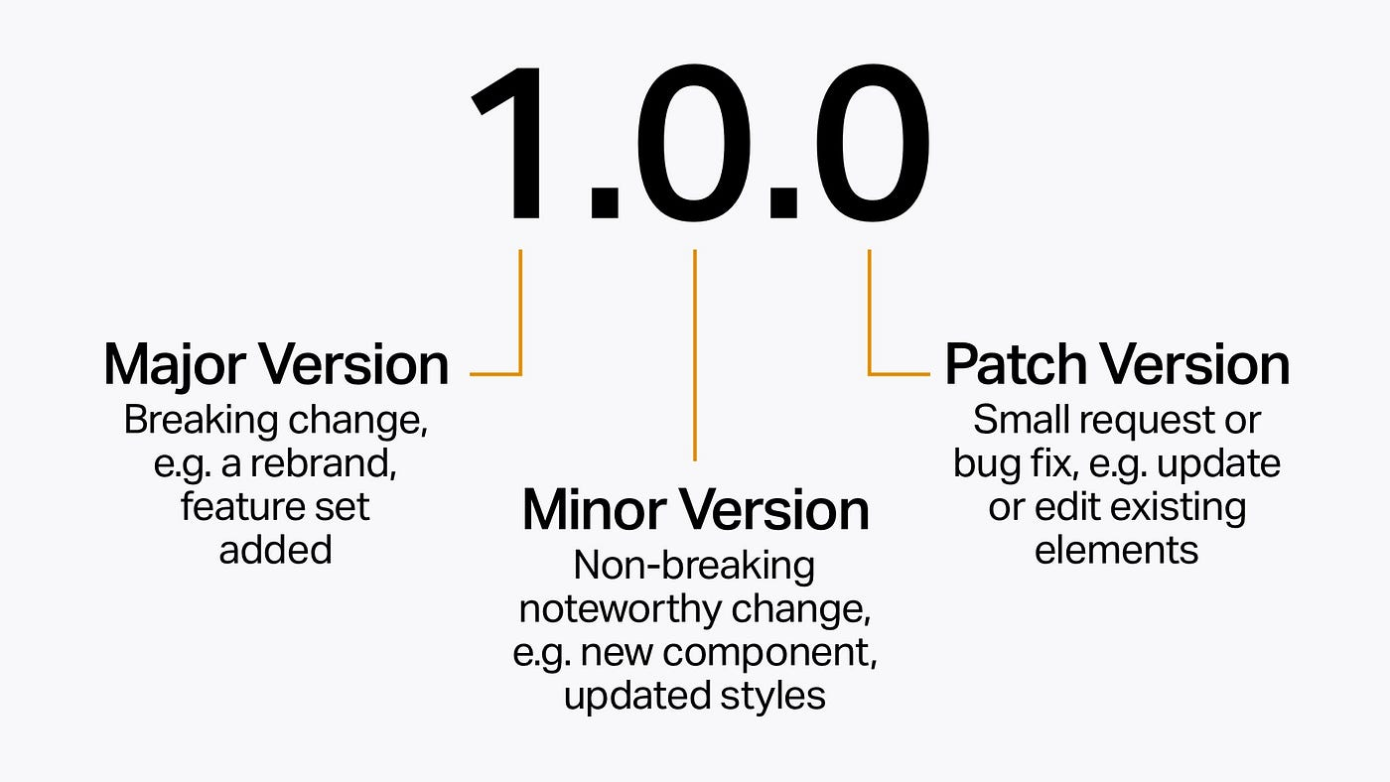
A small sidestep - Semantic versioning
Notes:
Ask the participants about their version numbering strategy.

Slide 13
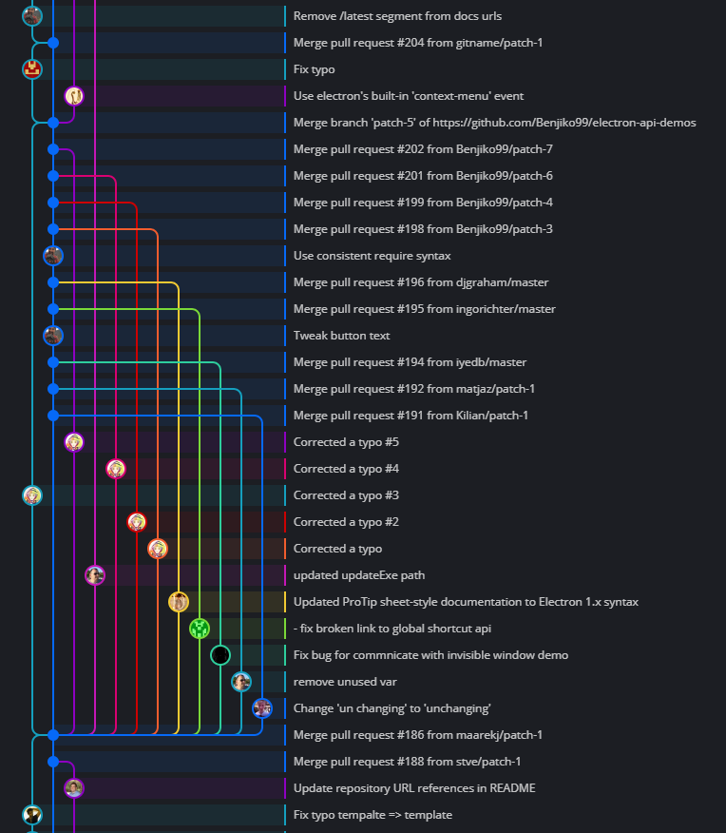
Back to GitVersion
Generates a version number based on the graph in Git.
You can use this to:
Always update the version number when commits are added (useful during greenfield development)
Update the version number when a branch is merged (useful when doing maintenance on a released project)
Update the version number when an explicit message is found in a commit
Use a tag in the Git graph to determine the version number.
Full information can be found on https://gitversion.net/docs/
Notes:
Show usage of ‘dotnet gitversion’ tool in MO99 folder.
Ga naar een andere branch en toon ‘dotnet gitversion’ opnieuw.
Show Gitversion.yml configuration file in MO99 folder.
Show usage of GitVersion in Azure build pipelines in MO99 folder.

Slide 14
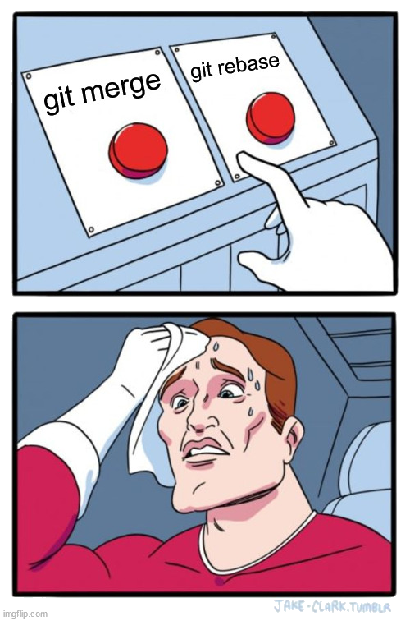
The eternal debate
Your opinion? And why?
Notes:
Merge into, rebase onto

Slide 15
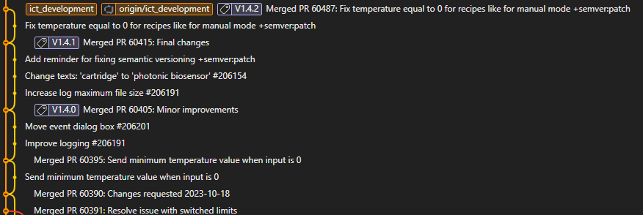
Why not use both?
Rebase your feature branch
Merge the rebased feature branch to main using git merge --no-ff
This will result in creating an (empty) merge commit linking both branches together
Screwed up the merge? Use either:
Git reset
git revert -m 1 <merge-commit-hash>

Slide 16
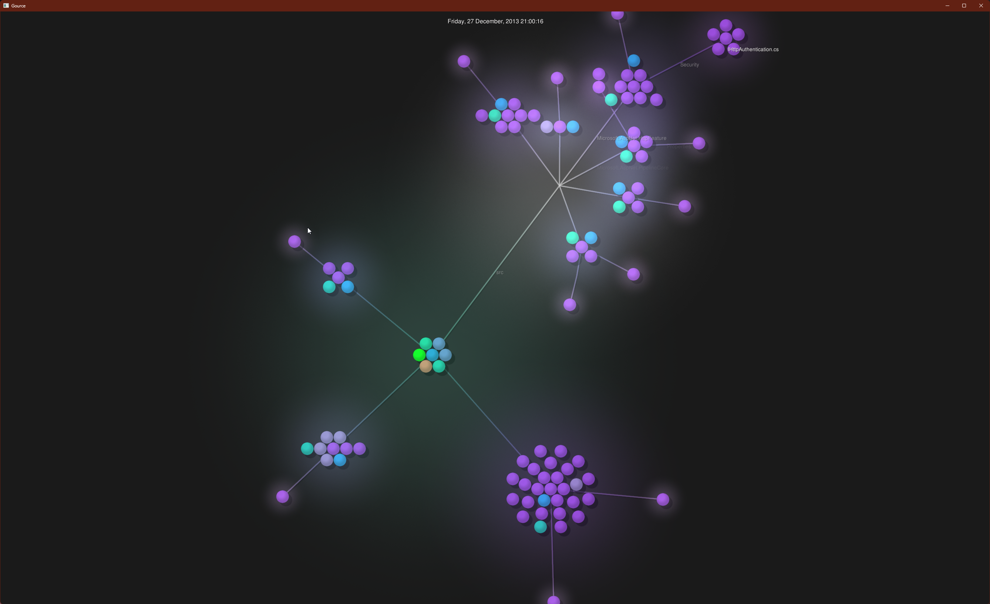
Fun stuff – visualize your git activity
Using https://gource.io/
Notes:
gource --seconds-per-day 1 [repository folder]

Slide 17
Useful Git commands
Your log in graphical ASCII format git log --graph --decorate --oneline
Search your files for a commit with a given string git log -S "A promise in JavaScript is very similar“
Find your most active contributors git shortlog –ns
Grep within git https://www.kosli.com/blog/git-grep-like-a-pro-the-complete-guide/
Git restore (git restore --<sha> somefile.py) Instead of using git reset to achieve the same.
Git switch instead of git checkout <branchname>
Git worktree to work on multiple branches in different folders git worktree add -b hotfix ./hotfix master
Create a secondary branch as backup against rebases
Notes:
Voor git log: zoek in de MO99 directory op git log –S “Fixed”
Git grep ‘readonly’
Toon linenumbers:
Git grep –n <string>
Zoek in een branch:
Git grep <string> <branch name>
Zoek in een branch tussen specifieke SHA’s
Git grep <string> <begin SHA> <eind SHA> <branch name>

Slide 18
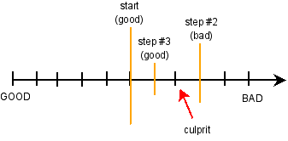
Git bisect – let Git find that bug for you
You discover a bug that has been in your code since a month. How are you going to find which commit introduced this bug?
- Let Git do a binary search for you

Slide 19
Git bisect – how to use
Tell Git when the bug was present and when it is not. (git bisect start <bad> <good>)
After each search by Git, tell it if it is bad or good until the offending commit is found.
Requires good commits (compiles and runs preferably)
Notes:
Demo geven
Aangeven dat v1.0 goed is. HEAD is slecht.
Commando’s:
Git checkout v1.0. Daarna run.cmd draaien.
Git checkout master. Daarna run.cmd draaien
- Git bisect start
- Git bisect bad (current head)
- Git bisect good v1.0
Daarna continue git bisect bad/good draaien totdat je bij de commit komt die dit geintroduceerd heeft.
Via gitk –all laten zien waar je zit.

Slide 20
Tooling to rewrite your Git repositories
From oldest (no longer recommended) to newest:
git filterbranch command. Built-in but takes ages to run.
Custom tool (Java executable) BFG Repo-cleaner
Custom tool (Python script) git-filter-repo
Destructive operation - will rewrite your history so afterwards your users will need to clone this new repository.
Foo
Folder structure:
Foo
Bar
Bar
Notes:
Tonen hoe we BFG Repo-cleaner kunnen gebruiken.
Download the JAR file op https://rtyley.github.io/bfg-repo-cleaner/
Commandline opties laten zien via ‘java –jar bfg.jar’
Demo met: java -jar bfg.jar --delete-folders .azure .\bfgtest\
Uitleggen dat wijzigingen in HEAD niet aangeraakt worden.

Slide 21
Reference material
How Git works - https://wizardzines.com/zines/git/ Best 12 euros you will ever spend
Beej’s guide to Git

